Slide 1
GH fit comparisons
5/2/24

Slide 2
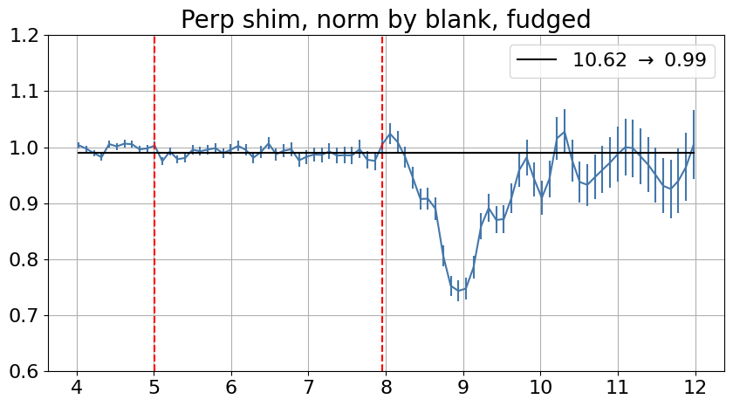
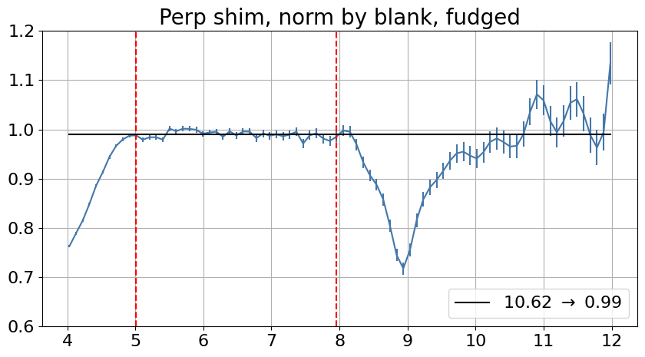
Perpendicular
Without fitting blank shim
Fitting blank shim to log(I) = a*lambda + b in the region 5 to 10 Angstroms
Red dashed lines show the “fudge region” where I took the average value (here 10.62) to renormalize the data to 0.99.

Slide 3
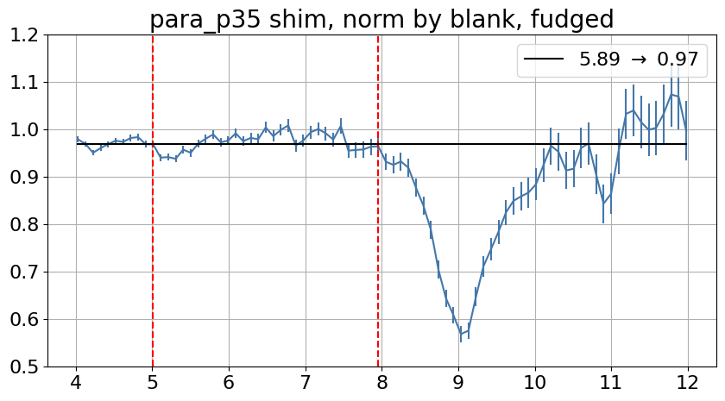
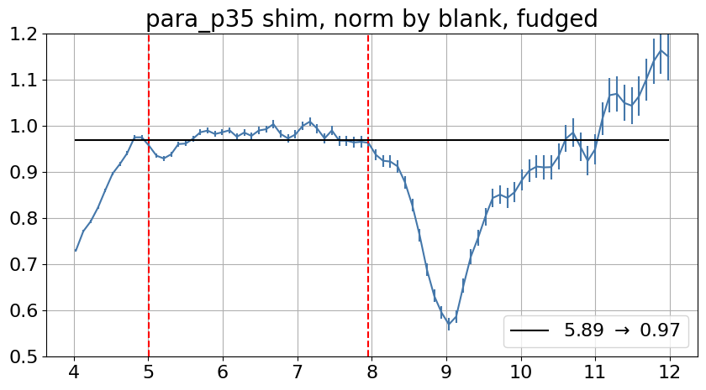
Parallel
Without fitting blank shim
Fitting blank shim to log(I) = a*lambda + b in the region 5 to 10 Angstroms

